Slide 1
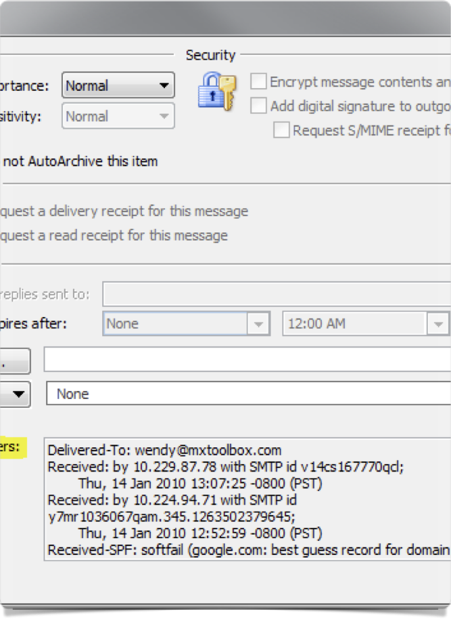
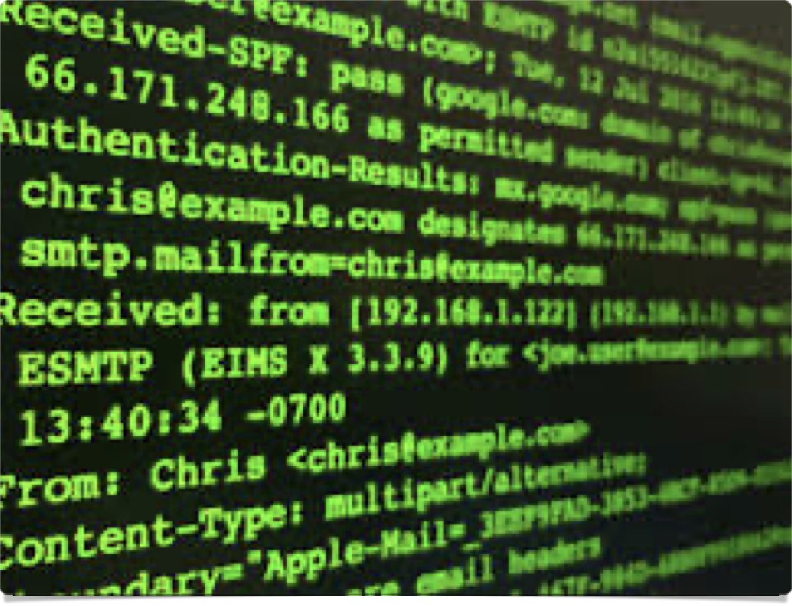
E-mail headers 101

Slide 2

Who is this guy
Aaron J. Scantlin
Adjunct Professor - College of Engineering
Security Analyst - MU Division of IT
Conduct Committee/DJ/Speaker - SecKC
GSEC, GCFA certified
Huge nerd

Slide 3

Notes:
The fuck are headers anyway

Slide 4

Notes:
You could read this but let me spare you the thrilling saga

Slide 5



Notes:
They’re basically logs for email

Slide 6

Notes:
This is useful because assholes use email and we can use headers to help us sniff out assholes

Slide 7

Notes:
Before we get into that tho let’s talk about how these headers are formed

Slide 8
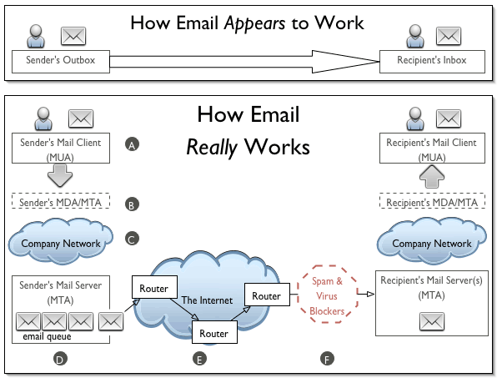
Notes:
In a nutshell, this is how email operates

Slide 9
Notes:
We’ll see headers potentially added to a message at any of these locations

Slide 10

Notes:
ok, cool - so what’s in these headers?

Slide 11
from
date
yes seriously
Notes:
These are the only fields you’re guaranteed… but in practice you’ll get a shitload more.

Slide 12
to
sender
dkim-signature
return-path
reply-to
cc
subject
bcc
received-spf
content-type
message-id
received
Notes:
however, in practice, you’re very likely to see all (or at least most) of the fields listed on this slide.

Slide 13
field name
:
field body
From: hackerman@missouri.edu
Date: Mon, 20 Apr 2020 16:20:00 +0100
Notes:
Message headers have a specific format shown here
Judging from these message fields, you would think the account hackerman@missouri.edu sent this e-mail on 4/20 at 4:20 PM in 2020.
(and if we didn’t have any other info, that would be pretty much the only assumption you could make)

Slide 14
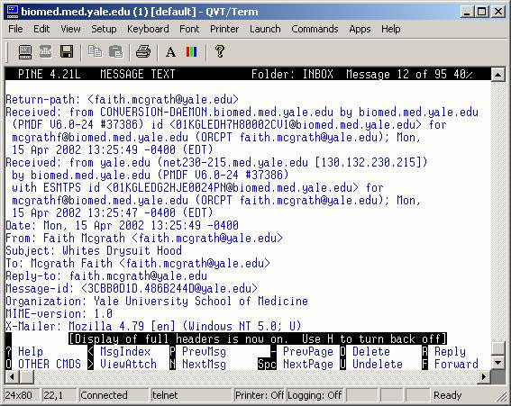
Notes:
But again, you’re not likely to see any e-mail that actually traversed the Internet come to you in that form - there’s usually a lot of shit to parse through, which is part of the problem; it’s not easy to parse in its raw form by a human.

Slide 15
field name
:
field body
From: hackerman@missouri.edu
Date: Mon, 20 Apr 2020 16:20:00 +0100
…
Sender: lol@gotem.tk
Notes:
Adding insult to injury, the fields might not always denote the info you’d think - for example, the From field isn’t necessarily the actual account used to send the message: that info is contained in the Sender header.

Slide 16

Notes:
Adding to the potential for confusion are what’s known as X headers - these are headers where the field is prefaced with an X to designate the fact that they’re “experimental”
They’re experimental insofar as the RFC for message headers states that any “permanent” message headers must have a published RFC associated with them - in practice, they’re what I’ll call “reliable enough” - we have no guarantee as to their accuracy or content, but absent a malicious mail server we won’t be misled by these headers.

Slide 17

Header parsing tools
MxToolbox (https://mxtoolbox.com/EmailHeaders.aspx)
Microsoft (https://mha.azurewebsites.net/)
MHA (https://github.com/lnxg33k/email-header-analyzer)
(and many more)
Notes:
No need to worry though - we’ve got plenty of tools we can use for the job
I prefer MHA because I can run it locally but I have no real reason to think MxToolbox or M$ give a shit about the headers I put in their tools, but feel free to use one of the online tools tonight if you don’t have one locally.

Slide 18
https://bit.ly/3btiR0p
Go grab the headers here to follow along
Notes:
now, if you trust me (and in this scenario you can), you can follow along as we parse four example e-mail headers to try and help us determine whether or not an e-mail is legitimate

Slide 19
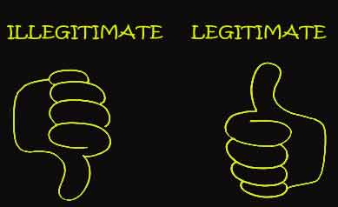
?
https://bit.ly/3btiR0p
Notes:
now, before we get into reviewing these headers, I want to make something clear: headers cannot, by themselves, determine whether an e-mail is legitimate or not. All they do is help you make an informed decision on whether or not the message is legitimate.
For example, let’s say an attacker has managed to compromise the mailbox of a contractor working for the University, and that attacker sends the person who pays the contractor a request to make their payment to a different account. Headers would indicate that the message legitimately came from the contractor’s mail server, so the only thing we’re left with to determine legitimacy is to confirm with the purported sender out of band.
The biggest thing the headers give you for messages that are spam or abuse is where to report that spam or abuse to.

Slide 20
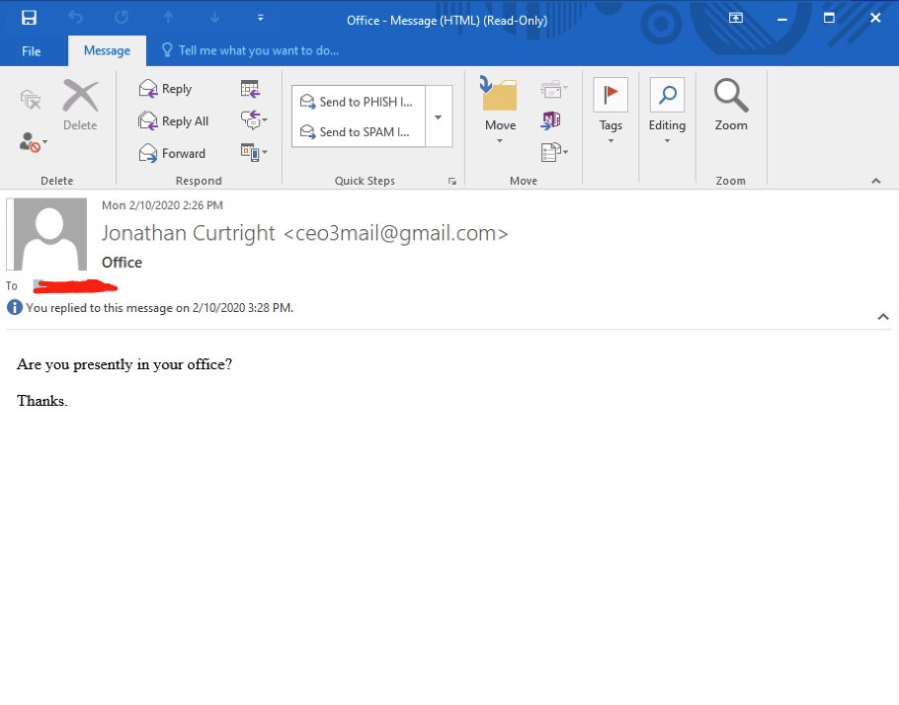
Notes:
Here we have the e-mail corresponding to header1.txt
Pretty obvious phish - this is known as a display name spoof

Slide 21
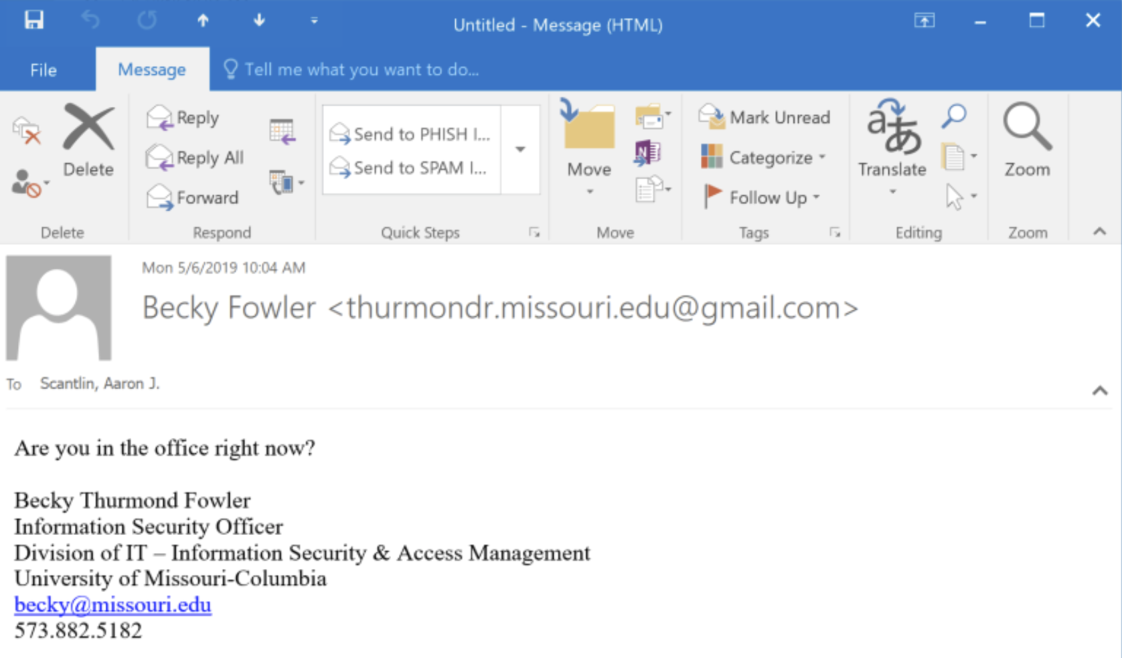
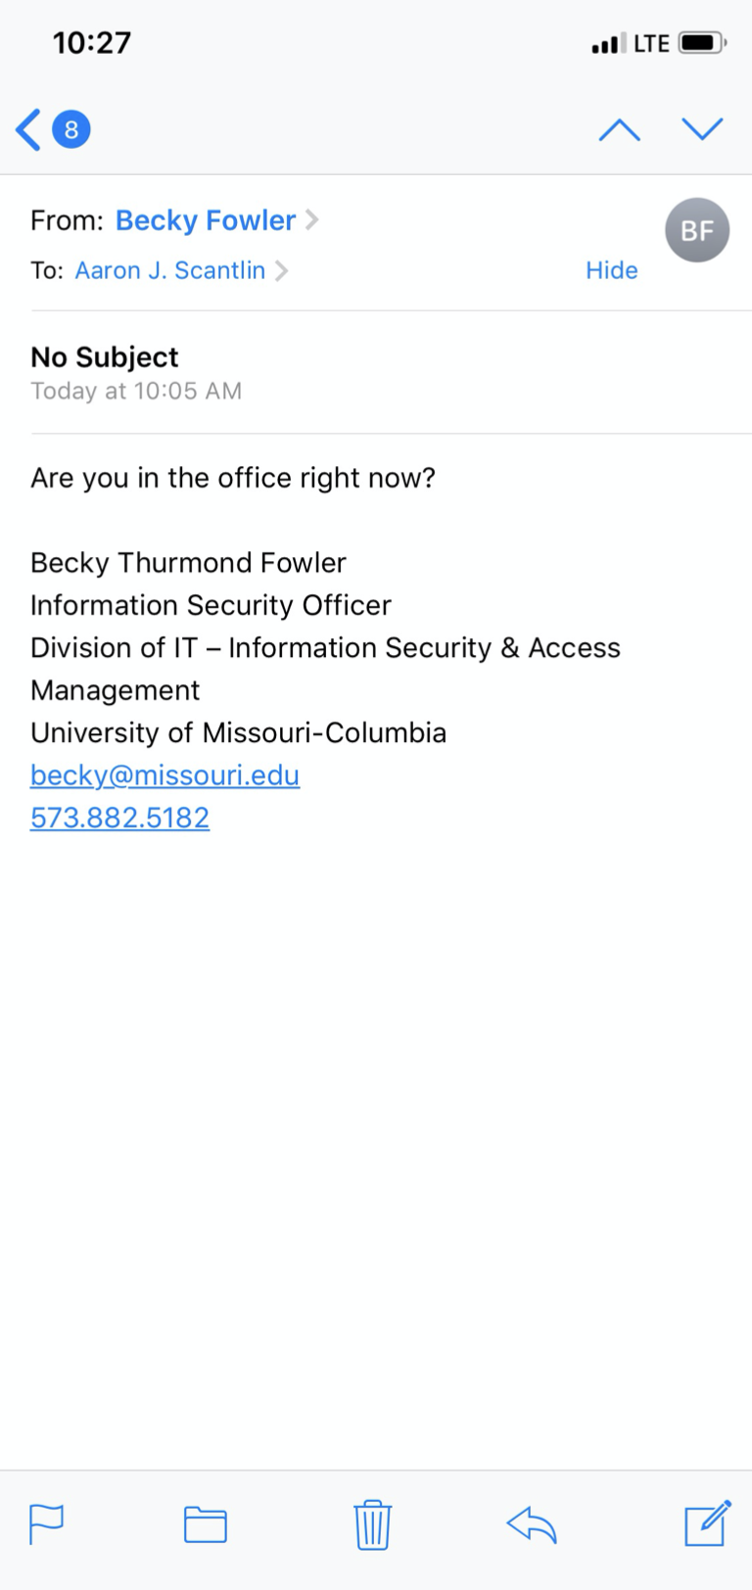
Mobile client
Desktop client
Notes:
As a brief aside, this is why display name spoofs work

Slide 22
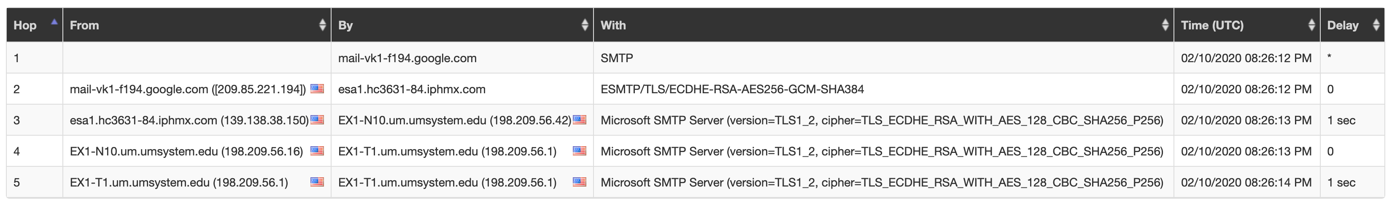
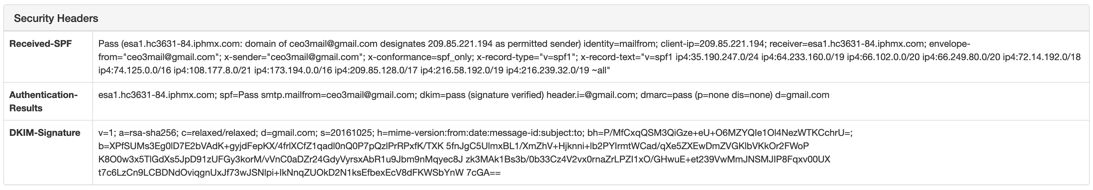
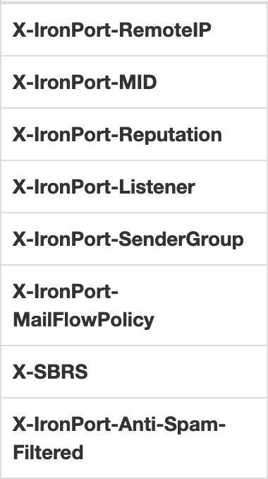
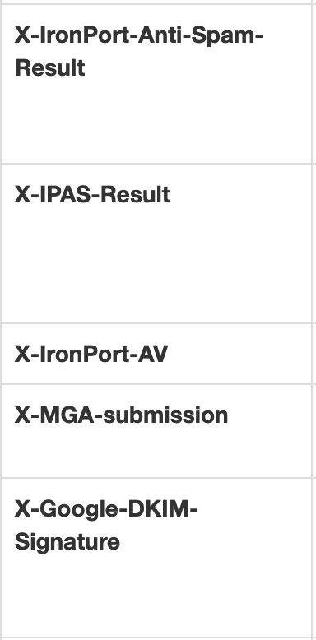
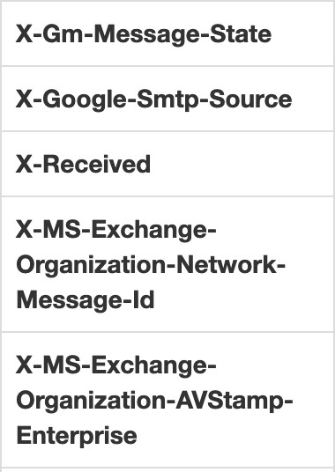
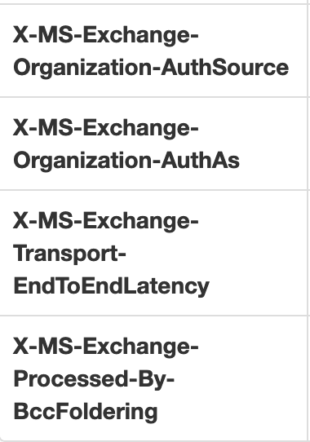
Notes:
Survey says: it’s a phish
What do we do with it? Report it to Google
Note that one simple trick some fishers use is to spoof the sending domain of one mail provider but actually use another, e.g. spoof Gmail but send from a Yahoo! Account - this is why, even in cases of obvious phish, one needs to check the headers: you need to report a phish to the org that can actually do something about it.

Slide 23
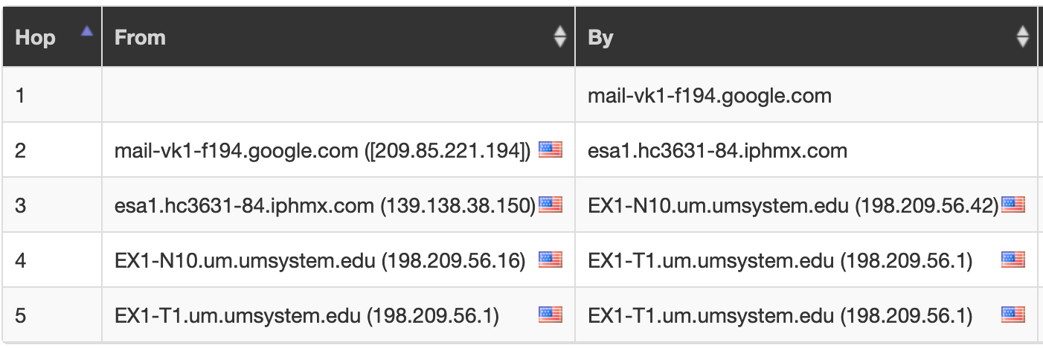
Notes:
It’s also important to know your own mail setup - I generally send abuse reports to the contact listed for the IP in the hop before it hits our mail servers. Looking at this, one might think the last hop before hitting University systems is the iphmx.com entry, but that’s actually our cloud-based iron port appliance - Google is indeed our last hop before hitting our infra.

Slide 24
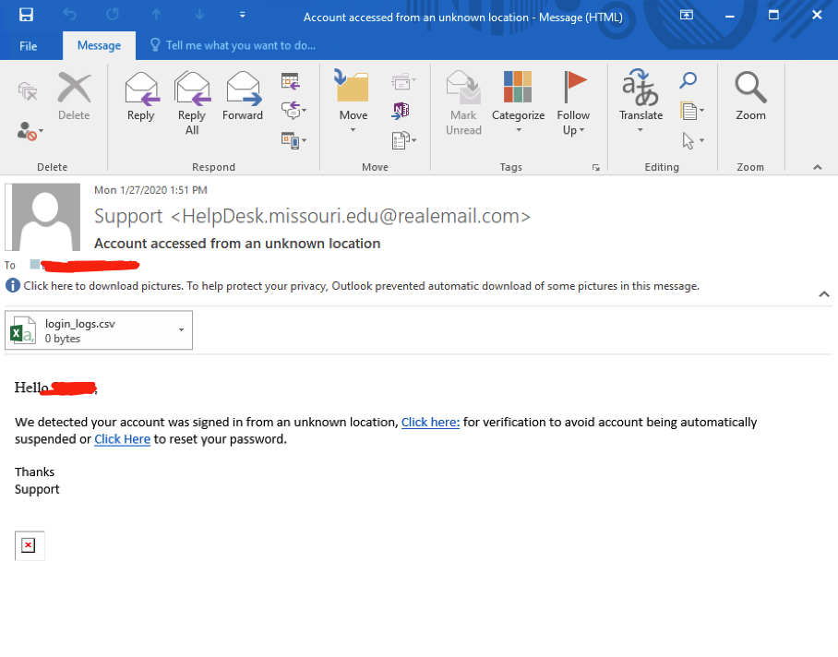
Notes:
Ok - another pretty obvious phish at first glance, but let’s take a look at the headers to see what we can learn

Slide 25
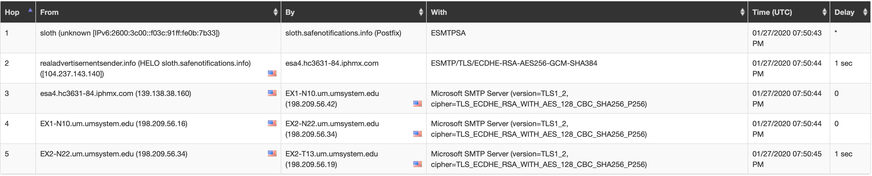
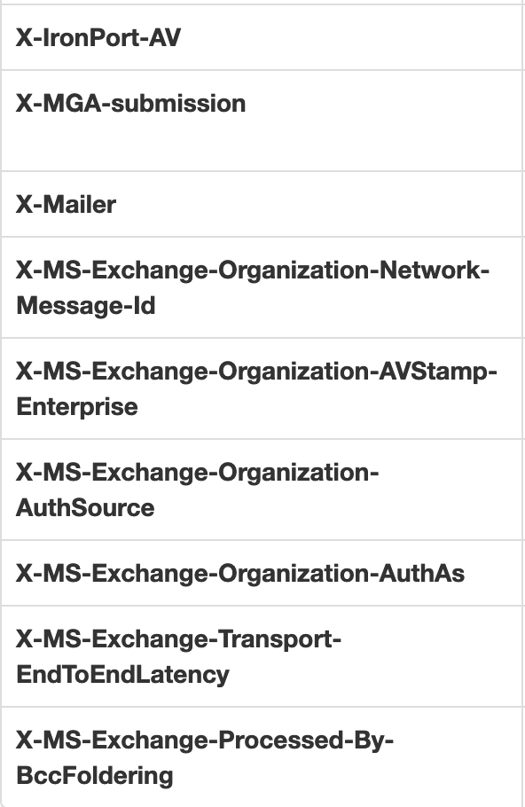
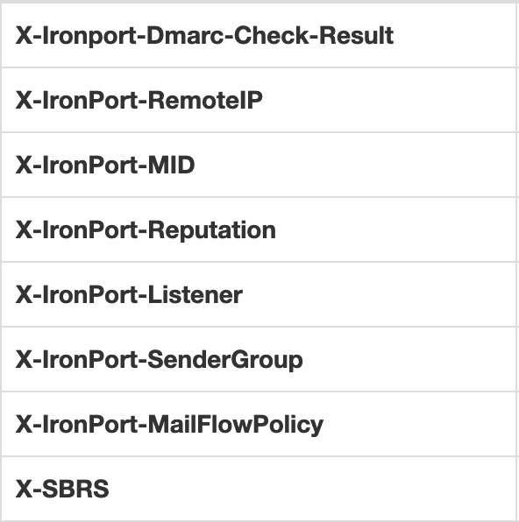
WHITELIST
$TRUSTED
Notes:
This time we’ve got some interesting X-Headers
In this case, this e-mail was from a self-phishing exercise we launched - however, if it were a real phish, there wouldn’t be much of a point in reporting it to the sending domain… “realemail.com" probably doesn’t give a shit if they’re phishing folks :(
In this case, you’d want to report that abuse to the hosting provider - if we do a whois on that IP, we can see that it resolves to Linode.
Quick shouts out to Linode for supporting self-phishing exercises.

Slide 26
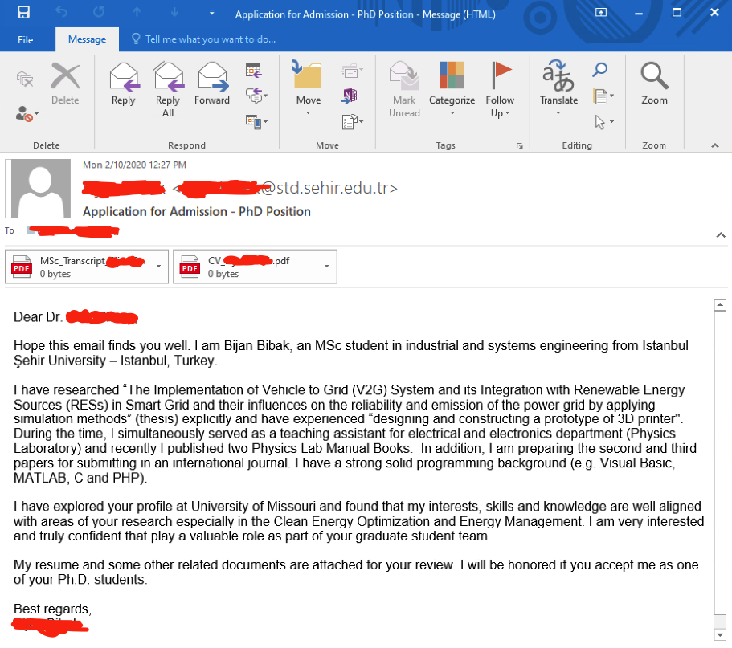
Notes:
Alright, let’s make things a bit more interesting! Here we’ve got an e-mail of unknown disposition with some attachments. It’s pretty common for fishers to target specific professors since there’s generally a fair amount of info about them and their research posted publicly, but it’s also very common for international students to directly contact professors who are interested in joining their program. So, let’s see what the headers can tell us.

Slide 27
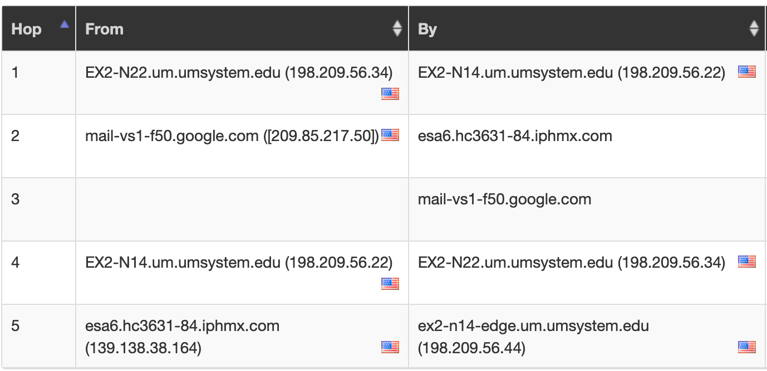
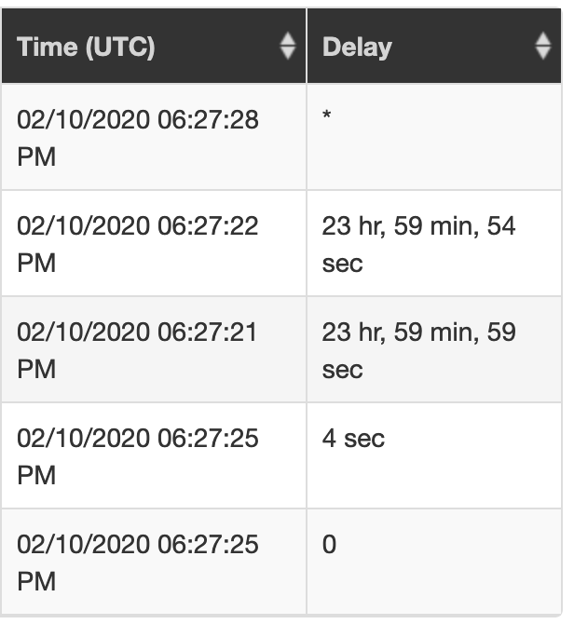
Notes:
First thing we notice is that the hop order is real funky.
This is common for messages that get held up in quarantine - in MHA, if you click on the Time column to order the rows by header field time, the hops will re-arrange to be in the proper order.

Slide 28
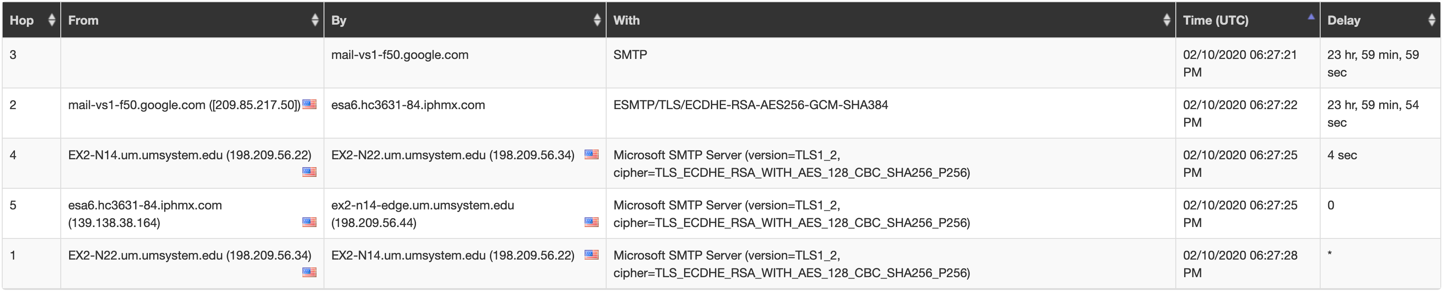
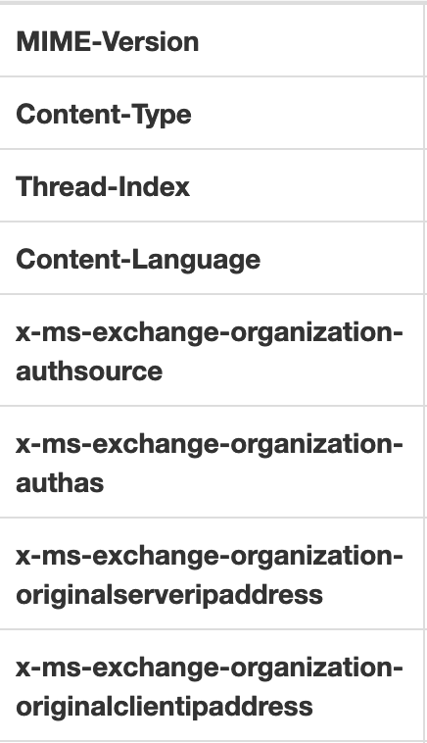
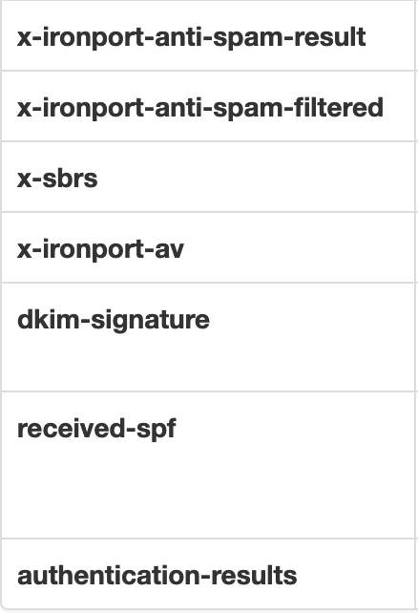
Notes:
Notice how our headers aren’t in exactly the same format? DKIM and SPF results have thus far been shown in the “Security Headers” section of MHA - they didn’t show up there this time because the header fields aren’t capitalized, but they are present.

Slide 29

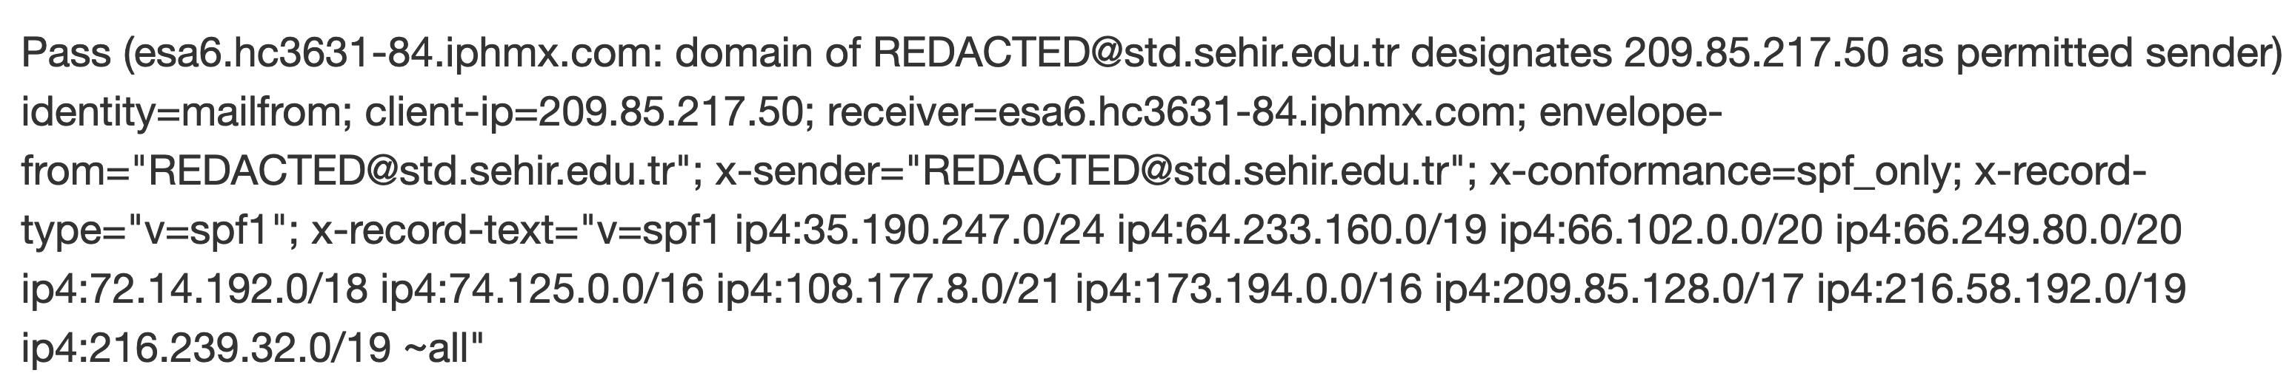
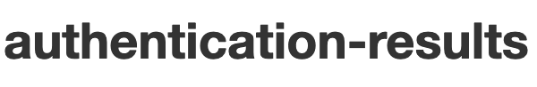
SPF and DKIM checks both pass
Notes:
Now I’m not gonna get real deep into SPF or DKIM since we’ve already had multiple good talks on that (and if you aren’t familiar, look up Caleb Christopher’s SecKC talk on SPF, DKIM and DMARC) but they do play into our decision-making process here, so for those of you who aren’t familiar, SPF and DKIM are both ways for a domain to designate who is permitted to send e-mail on its behalf (SPF does this by providing that information via DNS TXT record, and DKIM does this by signing the message using a private key and providing the public key in a DNS TXT record)
In fewer words: this message was legitimate sent from std.sehir.edu.tr

Slide 30
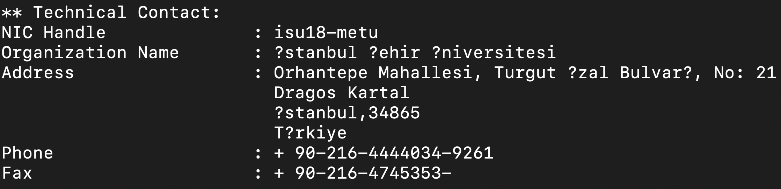
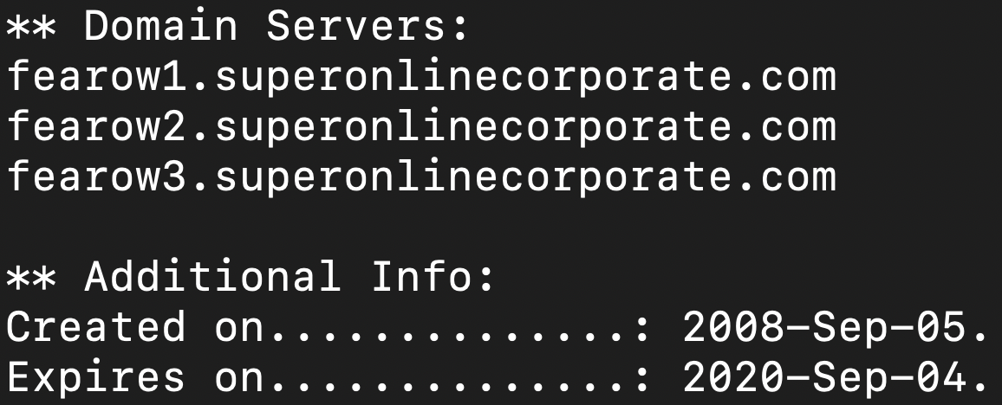

Slide 31
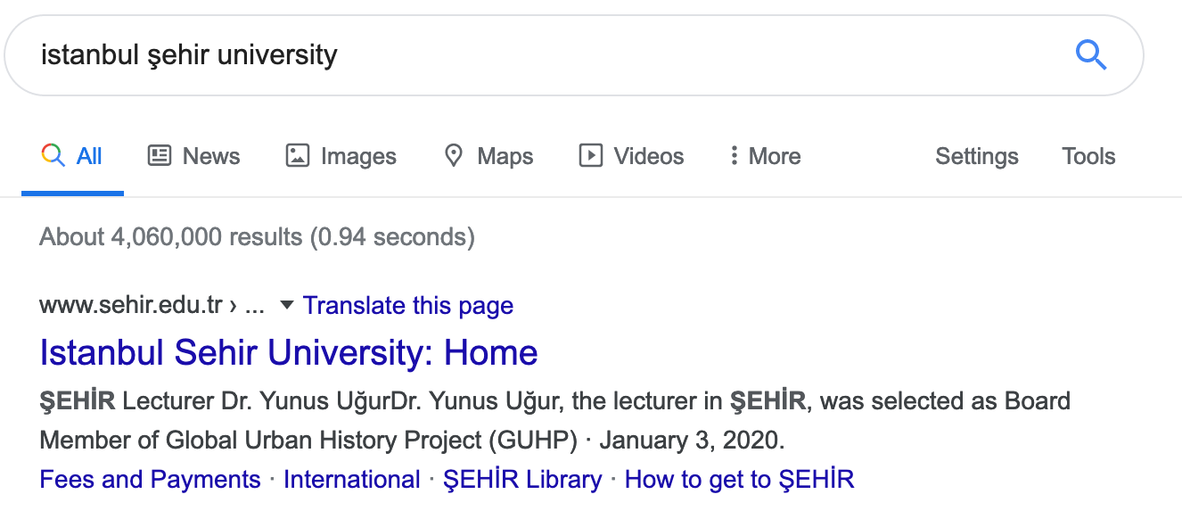
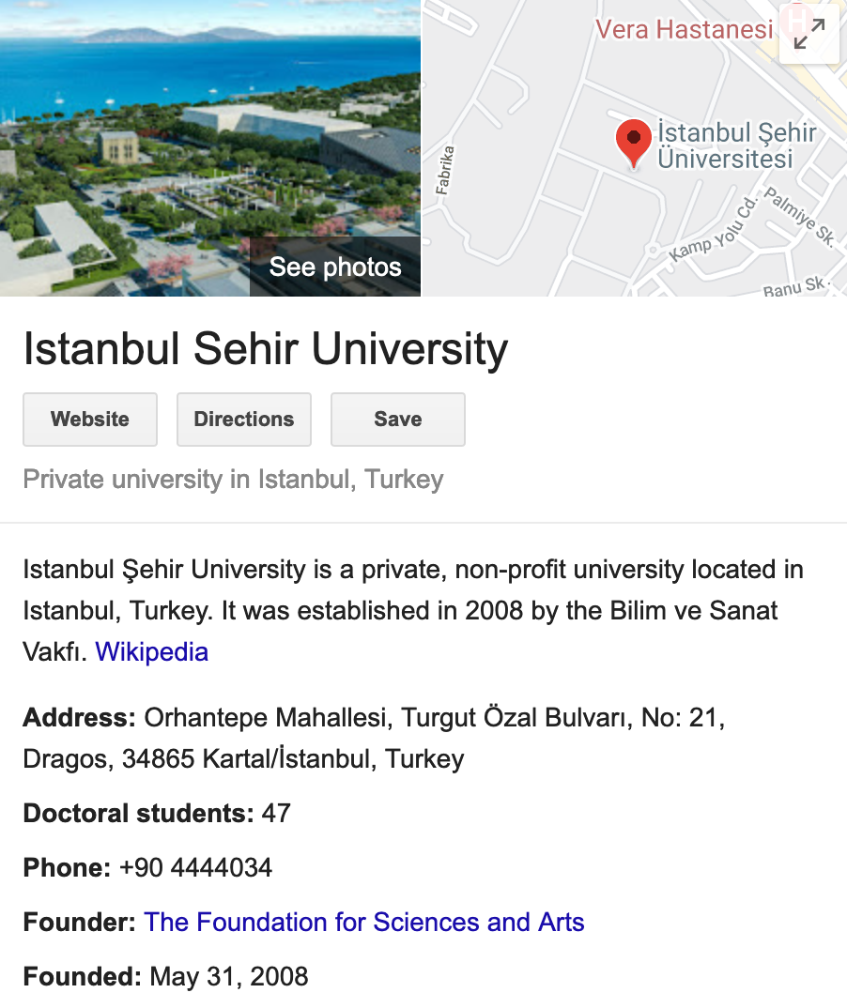



Slide 32
Notes:
Alright, so right now we know that this message was sent from sehir.edu.tr and we’re reasonably sure it’s a legitimate University - but, our header analysis hasn’t turned up enough information to say whether or not this is a legitimate message.
One of the ways to go about making an authoritative claim on legitimacy in this case would be to check out the attachments.

Slide 33

https://any.run
Notes:
Now this has nothing to do with headers, but since an analyst is often reviewing headers to determine whether or not a message is legitimate, I feel the need go into this topic just a bit.
One of my absolute favorite tools for this is any.run

Slide 34
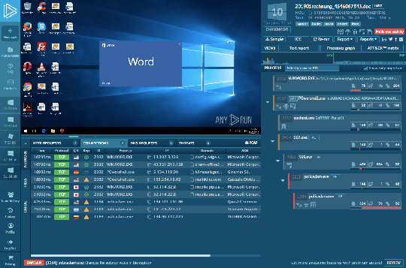
Notes:
I like it because it’s 1.) free, and 2.) it allows you to interact with whatever it is you’re scanning in realtime for up to five minutes with a free account. On top of that, it lists all the processes, HTTP requests, DNS requests, and much much more - fantastic for gathering IOCs on a suspicious file or URL.

Slide 35
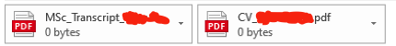
Notes:
However, it’s important to know when it’s right to use a public tool, and when it’s not - one of the downsides of using a free any.run account is that all your submissions are public. Now I’m not sure about you, but I’d be pretty fuckin’ pissed if I found out my transcripts were uploaded to a public repository where literally anyone could view them!
(That’s another fun topic for a future talk: sensitive documents uploaded to public file security scanning repositories.)
So in this case, you have two options: use a private scanning tool, or transfer to suspicious files to a disposable VM that isn’t connected to your corporate network.
If you’re an Infragard member, there’s a free private scanning tool called provided by I-LEAP available in the Infragard Portal. If you have the time and resources, you could setup something like Cuckoo Sandbox internally. Otherwise, I’m sure your friendly neighborhood security vendor would love to sell you something. :)
So what’s the verdict on this one? Turns out it was a legitimate message - but I’d much rather my users be safe than sorry.

Slide 36
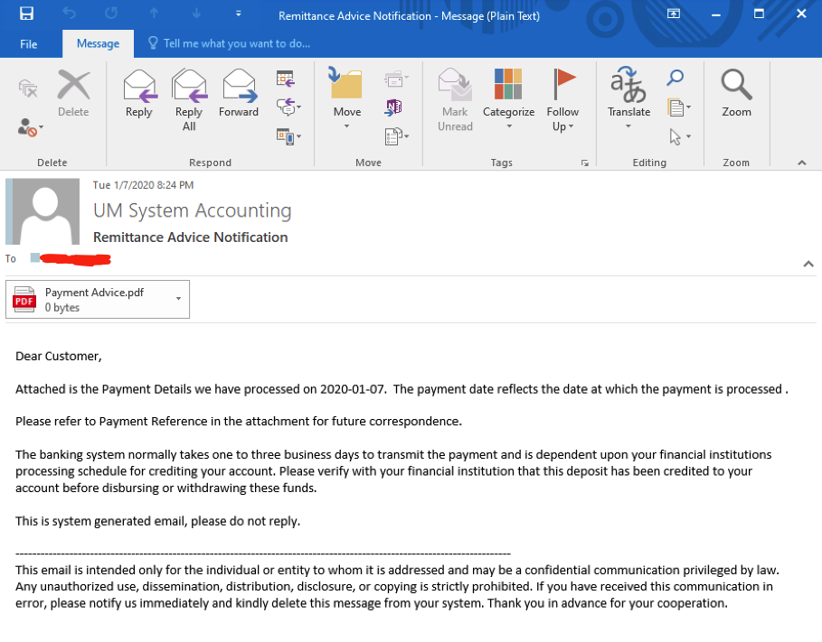
Notes:
Ok, last one before we wrap up and take any questions you might have.
Looks pretty garbo at first glance - let’s examine the headers.

Slide 37
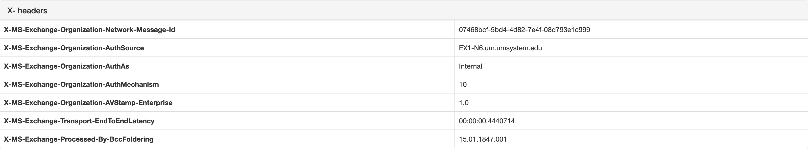
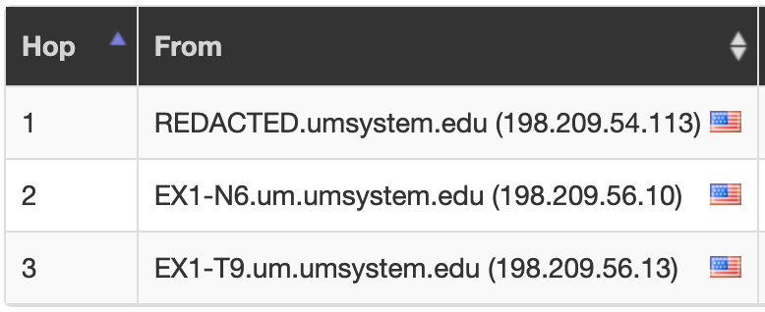
Notes:
Oh, uh… well… that was unexpected!
If we look at the hops, we can see that this was in fact generated by a umsystem.edu machine.
Additionally, we can see that there’s an X Header indicating that this was an internal e-mail.

Slide 38

Notes:
But again, does that tell us this message is legitimate? NO! We just know that the e-mail was sent from an internal system. We’ll want to examine the attachment for additional verification of legitimacy, but again, we probably don’t want to upload something like this to a public scanner.
After examining this attachment in a disposable VM, turns out it is indeed an invoice for a payment from UM System.

Slide 39
Notes:
But you really can’t blame the user for having reported this! We wound up asking the team that manages this server to modify the subject and contents of the body of the e-mail to make it sound a bit more authentic.

Slide 40

What headers are
Why they’re useful
How e-mail works at a high level
Where headers are applied
How headers are formatted
Some of the most common headers analyzed in infosec
How to analyze headers
Some ways to help determine legitimacy of an e-mail

Slide 41

Questions? Comments?
hackerman@missouri.edu
Huge thanks to Mizzou for always giving me the time to share the knowledge I gain through my work with our users!

